Slide 1
CARS PRICE PREDICTION PROJECT
Used cars data from cars24
Submitted by:
ABHILASHA MEWADA

Slide 2
INTRODUCTION
The production of cars has been steadily increasing in the past decade, with over 70 million passenger cars being produced in the year 2016. This has given rise to the used car market, which on its own has become a booming industry. The recent advent of online portals has facilitated the need for both the customer and the seller to be better informed about the trends and patterns that determine the value of a used car in the market. Using Machine Learning Algorithms such as Lasso Regression, Multiple Regression and Regression trees, we will try to develop a statistical model which will be able to predict the price of a used car, based on previous consumer data and a given set of features.
We are required to model the price of cars with the available independent variables. It will be used by the management to understand how exactly the prices vary with the independent variables. They can accordingly manipulate the design of the cars, the business strategy etc. to meet certain price levels. Further, the model will be a good way for management to understand the pricing dynamics of a new market..

Slide 3
Analytical Problem Framing
Data Sources and their formats
Data is scraped form the cars24 and all data is of used cars in india from different cities. Than it stored in the form of csv and we can also later use it. Data frame has 11 columns and 5521 rows.
Data Pre-processing Done
Data pre-processing done with many steps, first we check info than we check the null values. it has many null values than we just remove them because it can affect the performance of the model.
We have describe the data than checked the correlation between the columns. We have checked outliers also but we have not removed it because it can affect the prediction.

Slide 4
Data Pre-processing Done
Encoding:
Outliers:
Encoding:
Label Encoding: is a popular encoding technique for handling categorical variables. In this technique, each label is assigned a unique integer based on alphabetical ordering.
Label Encoding challenges: there is a very high probability that the model captures the relationship between values like they were ordinal which isn't suitble for example for ocean proximity here.
Outliers:
"An outlier is an observation that lies an abnormal distance from other values in a random sample from a population. In a sense, this definition leaves it up to the analyst (or a consensus process) to decide what will be considered abnormal. Before abnormal observations can be singled out, it is necessary to characterize normal observations. Two activities are essential for characterizing a set of data of the overall shape of the graphed data for important features, including symmetry and departures from assumptions of the data for unusual observations that are far removed from the mass of data. These points are often referred to as outliers. Two graphical techniques for identifying outliers, scatter plots and box plots, along with an analytic procedure for detecting outliers when the distribution is normal (Grubbs' Test)"}]

Slide 5
Hardware and Software Requirements and Tools Used
import pandas as pd
import numpy as np
import matplotlib.pyplot as plt
import seaborn as sns
from sklearn.preprocessing import StandardScaler,MinMaxScaler,power_transform
from sklearn.linear_model import LinearRegression,LogisticRegression
from sklearn.metrics import r2_score, mean_squared_error,accuracy_score,roc_auc_score,roc_curve,confusion_matrix,classification_report
from sklearn.ensemble import AdaBoostRegressor,
import warnings
warnings.filterwarnings('ignore')
from sklearn import preprocessing
import scipy.stats as stats
from scipy.stats import zscore
from sklearn.svm import SVC
from sklearn.naive_bayes import MultinomialNB

Slide 6
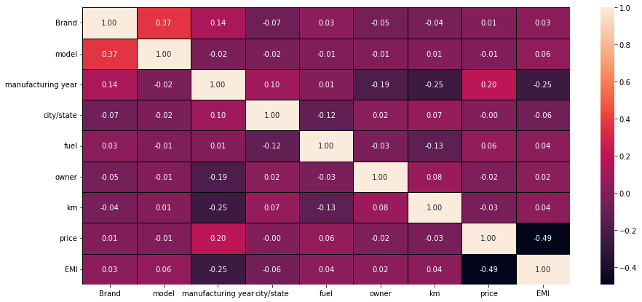

Slide 7
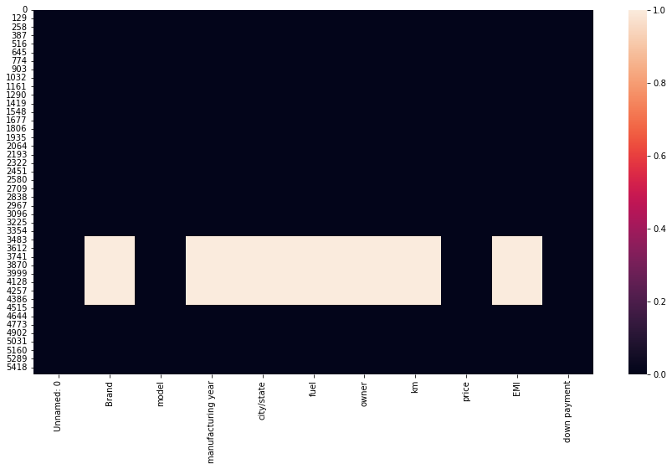

Slide 8
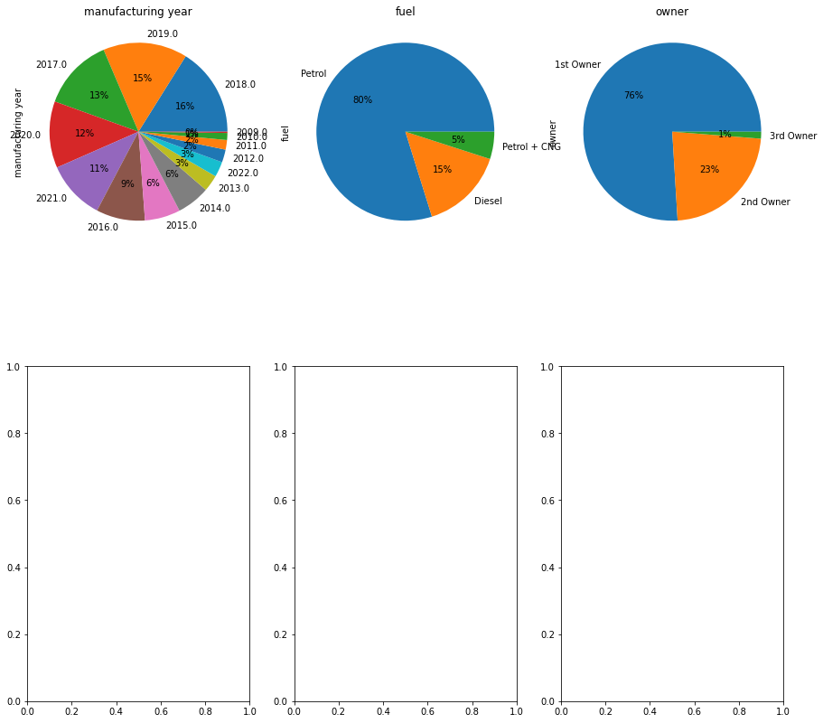

Slide 9
Conclusions:
1. We used several regression models to fit our data and it seems that they all succeeded to fit the data well and this indicated that the data pre-processing stage was also a success but we're still facing the problem of overfitting so I see that all models are truly promising and ready for the next stage of improvement to reduce overfitting.
2. Adaboost regression give the best regression model for cars price prediction.

